Slide 1
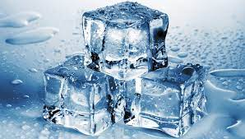
Cold like …

Slide 2
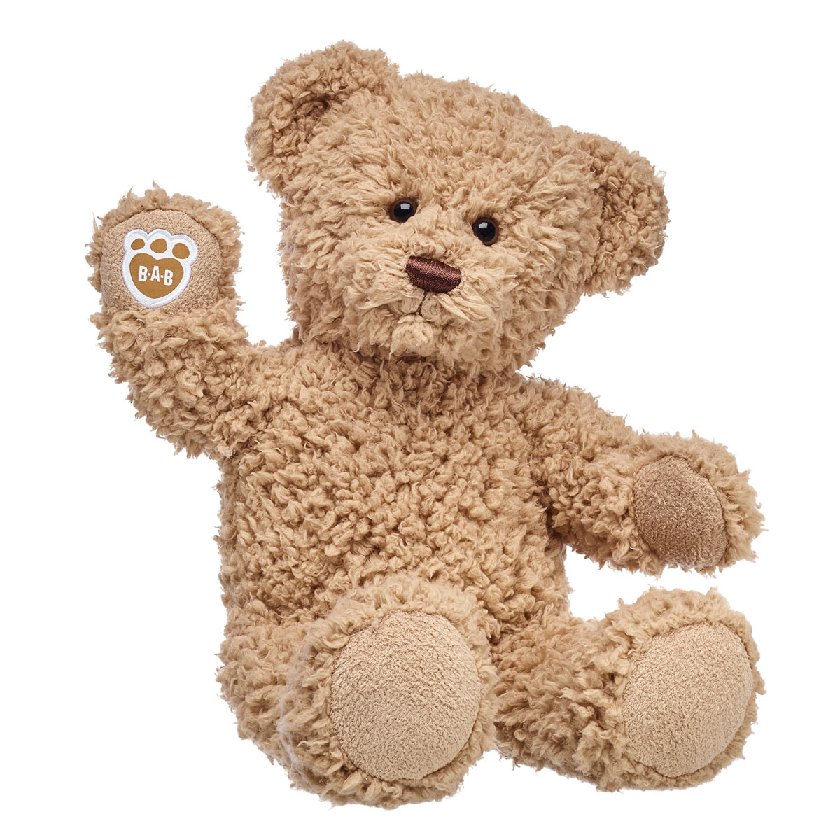
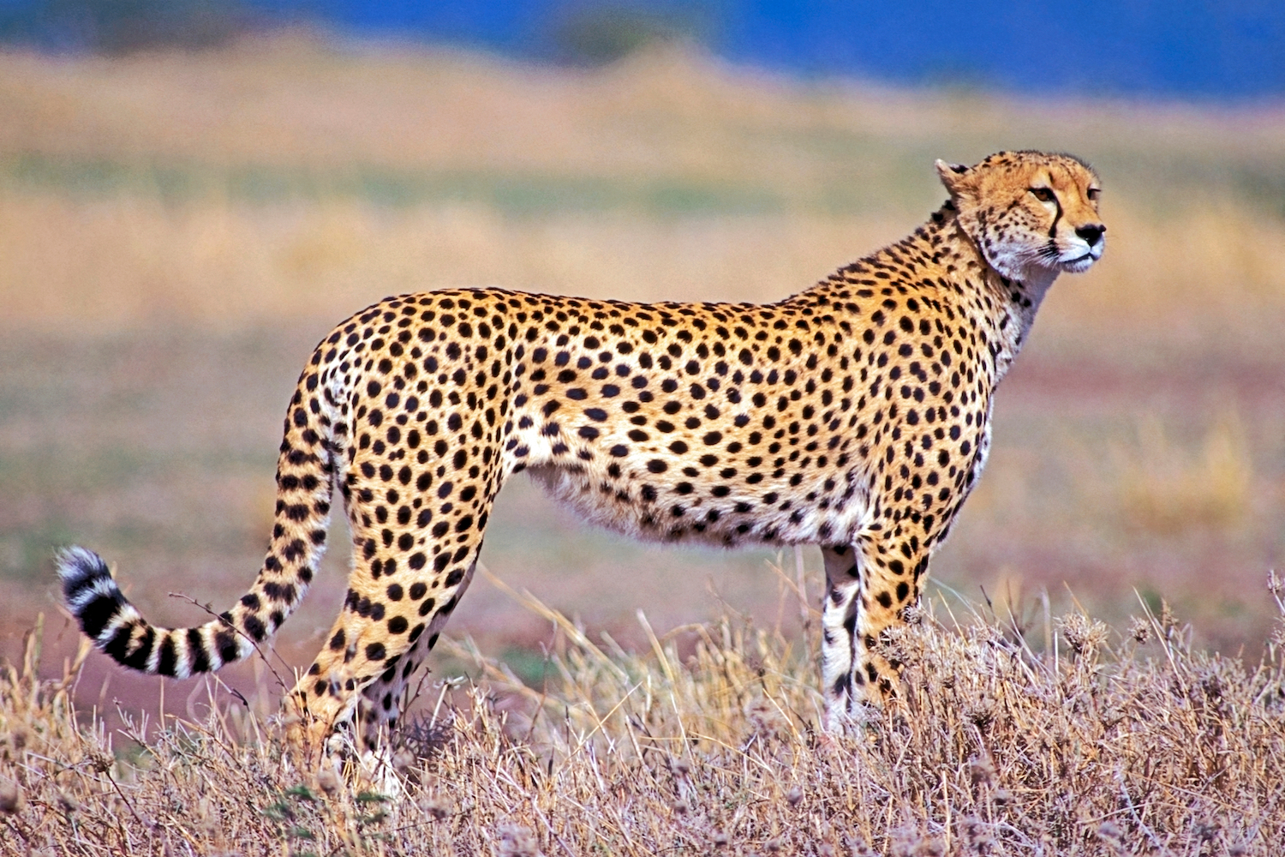
Green like …

Slide 3
Fast as a…

Slide 4
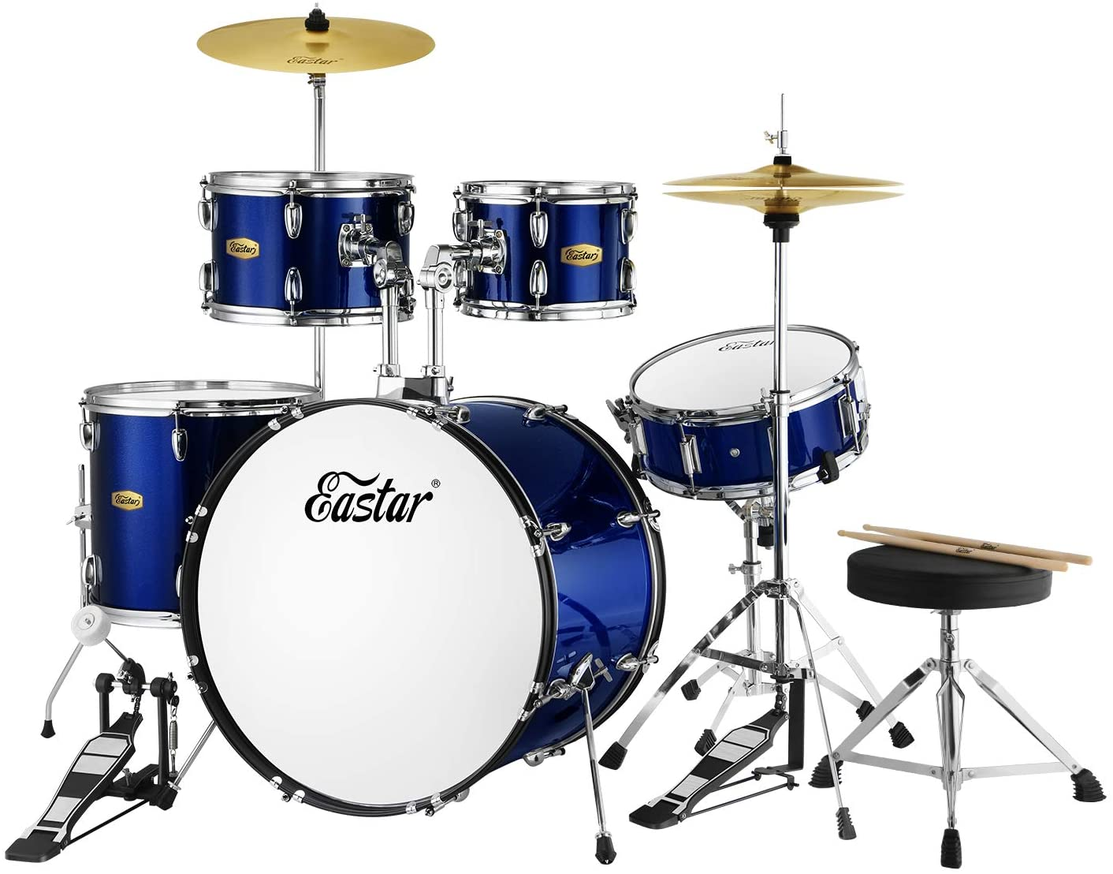
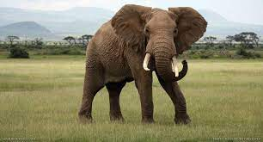
Soft like a…

Slide 5
Loud as a…

Slide 6
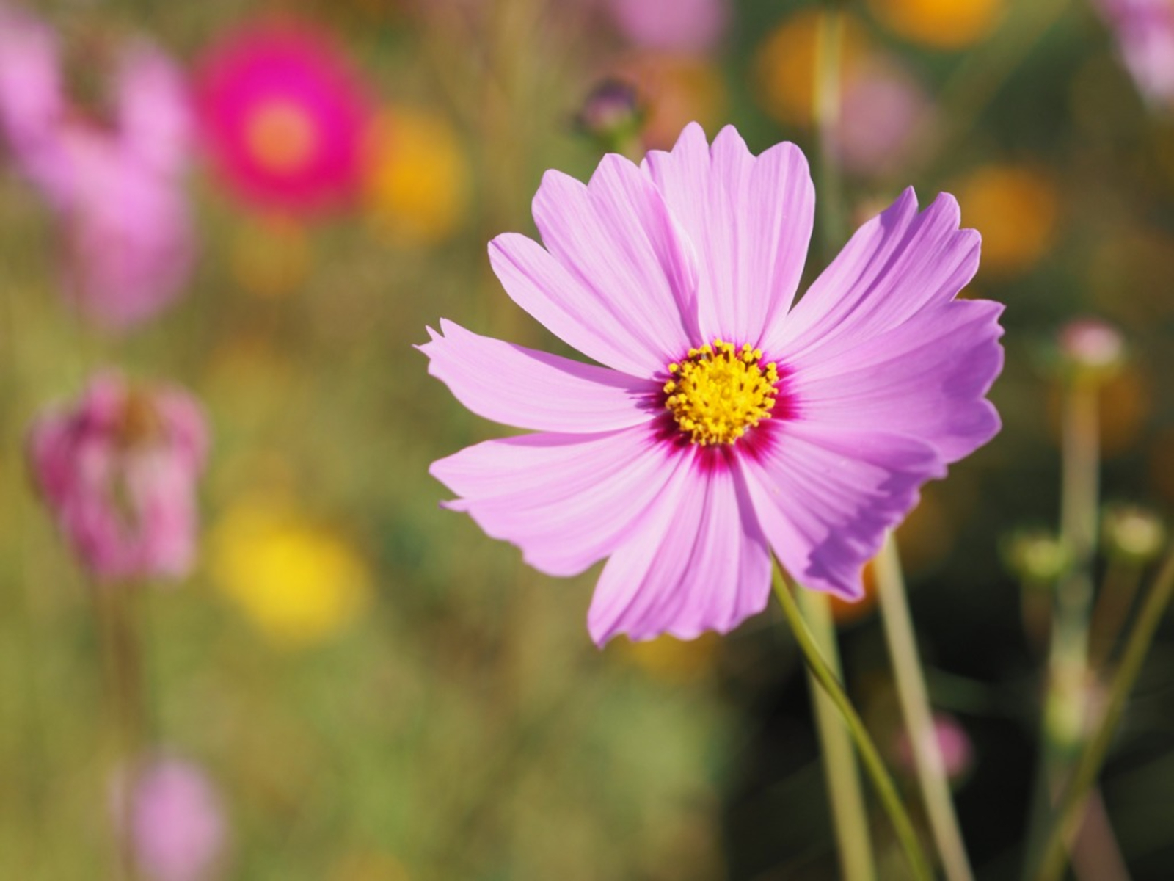
Hot like…

Slide 7
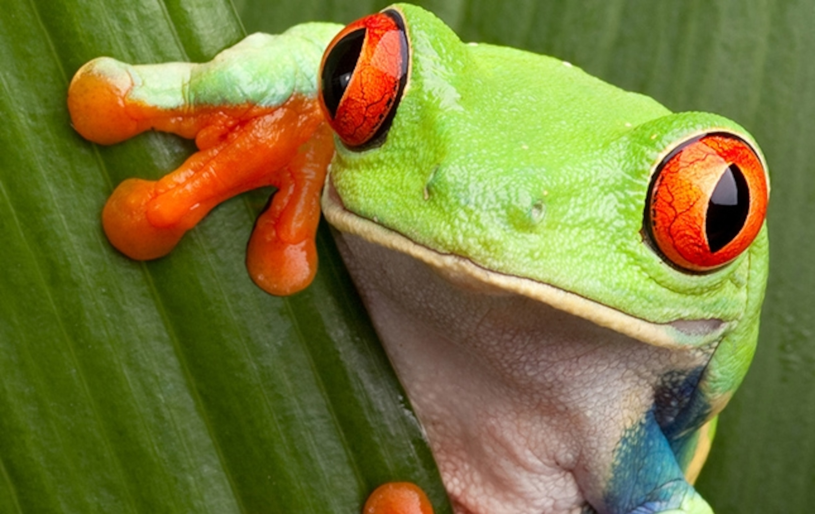
Pretty like…

Slide 8
Clever
Loving
Fast
Strong
Brave
Cuddly
Smiley
Thoughtful
Slow
Smart
Happy
Tall

