Slide 1

Phonics

Slide 2
What is Phonics?
Phonics is a method for teaching reading and writing.
It develops phonemic awareness – the ability to hear, recognise and use the sounds within words.
It teaches the correspondence between the sounds and the graphemes (spelling patterns) that represent them.
Phonics is currently the main way in which children in British primary schools are taught to read and write in KS1.
Children will also be taught other skills, such as whole-word recognition, book skills and a love and enjoyment of reading.
Notes:
Children develop awareness of different sounds in spoken language from a very early age.
Spoken words are made up of different sounds. When we teach children phonics, they learn to match these sounds to letters.
Phonics is about children knowing how letters link to sounds
The children then use this when they are reading and writing.
The ability to read and write well is a vital skill for all children, paving the way for an enjoyable and successful school experience.

Slide 3
Phonics Terminology

Slide 4


Phoneme: The smallest unit of sound in a word.
a
Grapheme: The letter or letters that represent the phoneme.
or
Digraph: two letters that make the same sound.
igh
trigraph: three letters that make the same sound.
Notes:
Phonemes are the speech sounds that are found within a word – these are the smallest unit of sound in the word – e.g. Cat has three phonemes – c/a/t
Grapheme – the letter (or letters), we use to represent the sound in the word. This may be one of the 26 letters of the English alphabet, but as there are 44 sounds in spoken English some of the sounds are represented by 2 letters – we call these
Digraphs.
Some sounds are represented by a pattern of three letters – we call these
Trigraphs.
We do use this terminology with the children in lessons – if they can learn the word tyrannosaurus, they can learn digraph!

Slide 5
A phoneme you hear
A grapheme you see
A word always has the same number of phonemes and graphemes!

Slide 6
Tricky Words
Words that cannot be decoded using phonics
no
Notes:
These are words that phonics does not work on – at least one of the letters in the word is not making it’s taught sound
e.g. in the word no, the n makes its sound, but the o doesn’t. It doesn’t say o. It says oa.
These words we just have to memorise by sight.
Some are ‘tricky’ to start with but will become decodable once we have learned the harder phonemes
e.g. out, there

Slide 7



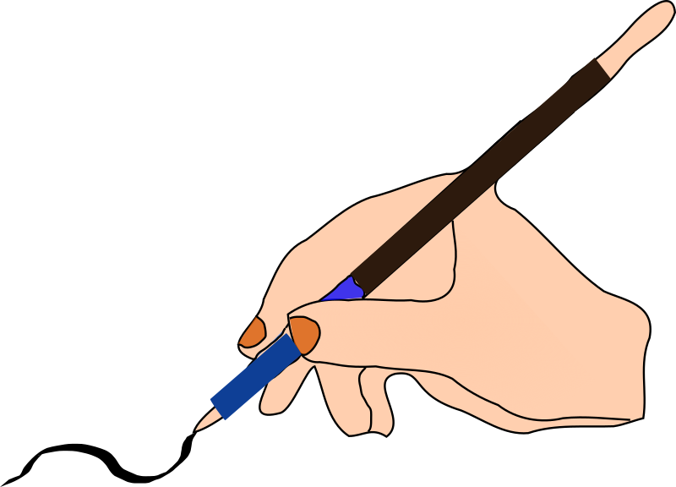
Blending: recognising the letters in a written word and merging them in the order they are written to pronounce the word.
cup
Segmenting: Identifying the individual sounds in a spoken word and writing down the letters for each sound to form the word
dog

Slide 8
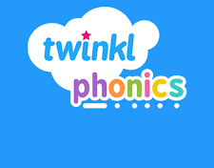
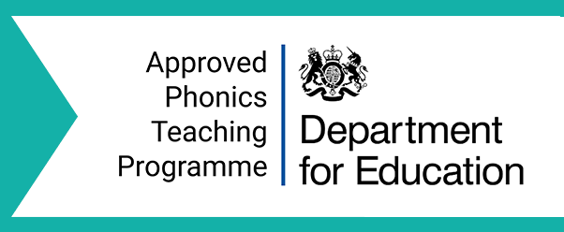
Phonics Teaching and Learning
We follow the validated scheme Twinkl phonics
Government approved phonics teaching programme
Based on Letters and Sounds
Notes:
This is a Government approved phonics teaching programme.
It follows the structure of the previously used Letters and Sounds programme. Letters and Sounds is a resource for the teaching of phonics which was issued by the Department for Education in 2007.
It remains the most common way to teach phonics in British primary schools.
It is divided into six sections, or phases, intended to begin in the preschool years and finish at the end of year 2 (age 7).
Each phase builds on the skills and knowledge of previous learning.
Children have time to practise and rapidly expand their ability to read and spell words.
They are also taught to read and spell ‘tricky words’, which are words with spellings that are unusual.

Slide 9
The 6 Phases of Phonics
Phase/Level | When is this taught? | What does it cover?
1 | Preschool/ Foundation | Listening & attention skills
2
3
4
5
6
Notes:
Each phase builds on the skills and knowledge of previous learning.
Children have time to practise and rapidly expand their ability to read and spell words.
They are also taught to read and spell ‘tricky words’, which are words with spellings that are unusual.
Environmental sounds – sounds we hear around us every day; listening to and imitating sounds; how to be a good listener. Ideas – make sounds to copy, e.g. sh sh sh, zzzzzz, p-p-p-p; go on a ‘listening walk’ – what can you hear?; talk about how to be a good listener; sing songs that require repetition and response, e.g. ‘Old MacDonald’.
Instrumental sounds – listening to and discriminating the sounds made by different instruments. Ideas – make sounds with a range of different instruments (non-musical instruments such as pots, pans, home-made shakers will all do); play an echo game where children have to copy a rhythm; hide an instrument behind a box or screen and play it, children have to say which instrument you are playing.
Body percussion – using the body to create sounds and follow a song, rhyme or beat. Ideas – sing songs that require actions, such as ‘Wind the Bobbin Up’, ‘Heads, Shoulders, Knees and Toes’, ‘If You’re Happy and You Know It, Clap Your Hands’; pass a body percussion sound around a group, e.g. sit in a circle or opposite one another, take turns to produce a body percussion sound which is then passed on, e.g. tap on shoulders, clap hands, stamp feet.
Rhythm and rhyme – recognising rhythms and rhymes in songs, speech and nursery rhymes. Ideas – sing and chant rhyming songs; read stories with repetition and rhyme, e.g. ‘The Gingerbread Man’, ‘Each Peach Pear Plum’; play a matching game with pictures of rhyming objects, e.g. frog/dog, hat/cat, mouse/house; clap the rhythm of phrases and rhymes or the syllables in words or names; play ‘I Spy’ – ‘I spy, with my little eye, something that rhymes with….’

Slide 10
The 6 Phases of Phonics
Phase/Level | When is this taught? | What does it cover?
1 | Preschool/ Foundation | Listening & attention skills
2 | Foundation | Alphabet sounds
3
4
5
6
Notes:
Phase 2
We will shortly be starting this phase in Foundation
In Phase 2, children begin to learn the phonemes and graphemes of the English alphabet.
Children have time to practise and rapidly expand their ability to read and spell words. They are also taught tricky words, Words in the English language for which the phonics code does not apply.
Phase 3 (Foundation) – We continue with the GPC’s of the English alphabet, and start to introduce more digraphs (2 letters making 1 sound) and trigraphs (3 letters making one sound) - There are 26 letters (graphemes) in the English alphabet, but there are 44 spoken sounds (phonemes). This means that some sounds are represented using 2, or 3, letters together.
Phase 4 (Foundation/Year 1)
Phase 5 (Year 1/Year 2)
Phase 6 (Year 2)

Slide 11
Children rapidly begin to read and spell real words
s a t p i n m d
sat pat tap sap at sit sat pip man mam din pit tip pin mat map did am it sip nip pan nap sad Tim tin tan dad dim dip Sam and ant
I, the, go, no, to,
go to the mat
Dad and Sam at the tip
Notes:
We do move through this phase quite rapidly, learning 3 or 4 sounds a week which means that children can rapidly expand their ability to read and spell words.
It can be an exciting time for children as they start to be able to decode writing, and reading books are sent home for practice.
They are also taught some common tricky words, - words in the English language for which the phonics code does not apply.
I, go, no, to, the
This means that children can start to read and write simple sentences.

Slide 12
The 6 Phases of Phonics
Phase/Level | When is this taught? | What does it cover?
1 | Preschool/ Foundation | Listening & attention skills
2 | Foundation | Alphabet sounds
3 | Foundation | Alphabet sounds + digraphs & trigraphs
4 | Foundation/ Year 1
5 | Year 1
6 | Year 2
Notes:
Phase 2
We will shortly be starting this phase in Foundation
In Phase 2, children begin to learn the phonemes and graphemes of the English alphabet.
Children have time to practise and rapidly expand their ability to read and spell words. They are also taught tricky words, Words in the English language for which the phonics code does not apply.
Phase 3 (Foundation) – We continue with the GPC’s of the English alphabet, and start to introduce more digraphs (2 letters making 1 sound) and trigraphs (3 letters making one sound) - There are 26 letters (graphemes) in the English alphabet, but there are 44 spoken sounds (phonemes). This means that some sounds are represented using 2, or 3, letters together.
Phase 4 (Foundation/Year 1)
Phase 5 (Year 1/Year 2)
Phase 6 (Year 2)

Slide 13
digraph:
oa (as in boat)
trigraph:
igh (as in high)
Tricky words:
he
she
we
me
be
you
are
her
was
all
they
my
fizz
chip
sheep
light
Notes:
There are 26 letters (graphemes) in the English alphabet, but there are 44 spoken sounds (phonemes). This means that some sounds are represented using 2 letters together – this is called a digraph – like oa as in boat
Some sounds are represented by 3 letters together – this is called a trigraph – like igh as in light
In this phase we start to read a wider set of CVC words, for example, fizz, chip, sheep, light.
These still have 3 sounds, but contain more letters. This can be a confusing stage for children – remind them to look for digraphs if they word does not make sense when they sound it out.
practise blending and segmenting
learn all letter names and begin to form them correctly
read more tricky words and begin to spell some of them
read and write words in phrases and sentences.
Set 6: j, v, w, x
Set 7: y, z, zz, qu
Consonant digraphs: ch, sh, th, ng
Vowel digraphs: ai, ee, igh, oa, oo, ar, or, ur, ow, oi, ear, air, ure, er

Slide 14
The 6 Phases of Phonics
Phase/Level | When is this taught? | What does it cover?
1 | Preschool/ Foundation | Listening & attention skills
2 | Foundation | Alphabet sounds
3 | Foundation | Alphabet sounds + digraphs & trigraphs
4 | Foundation/ Year 1
5 | Year 1
6 | Year 2
Notes:
Phase 2
We will shortly be starting this phase in Foundation
In Phase 2, children begin to learn the phonemes and graphemes of the English alphabet.
Children have time to practise and rapidly expand their ability to read and spell words. They are also taught tricky words, Words in the English language for which the phonics code does not apply.
Phase 3 (Foundation) – We continue with the GPC’s of the English alphabet, and start to introduce more digraphs (2 letters making 1 sound) and trigraphs (3 letters making one sound) - There are 26 letters (graphemes) in the English alphabet, but there are 44 spoken sounds (phonemes). This means that some sounds are represented using 2, or 3, letters together.
Phase 4 (Foundation/Year 1)
Phase 5 (Year 1/Year 2)
Phase 6 (Year 2)

Slide 15
The 6 Phases of Phonics
Phase/Level | When is this taught? | What does it cover?
1 | Preschool/ Foundation | Listening & attention skills
2 | Foundation | Alphabet sounds
3 | Foundation | Alphabet sounds + digraphs & trigraphs
4 | Foundation/ Year 1 | Longer words. More Tricky words.
5 | Year 1
6 | Year 2
Notes:
In Phase 4, Children continue to practise previously learned graphemes and phonemes and learn how to read and write longer words and sentences.
No further sounds taught at this phase. Some children will start this phase in Foundation, for other children this may happen in Year 1.
Reading & spelling words containing adjacent consonants e.g. crunch, float, groan.
Reading & spelling two syllable words
Learning some tricky words:
Tricky words
said, so, do, have, like, some, come, were, there, little, one, when, out, what

Slide 16
Tricky words
said
so
do
have
like
some
come
were
there
little
one
when
out
what
CVCC words:
tent
damp
toast
chimp
Multisyllabic
cooker
eating
shampoo
toast
CCVC words:
swim
plum
stork
cream
spoon
stork
Notes:
CVCC words: tent, damp, toast, chimp
For example, in the word ‘toast’, t = consonant, oa = vowel, s = consonant, t = consonant.
and CCVC words: swim, plum, sport, cream,
spoon
Notice that the ‘s’ and ‘t’ at the end of toast and the start of stork combine to make the same sound – ‘st’ – we call this a consonant blend. They are still different phonemes but blended quickly together they combine to make st

Slide 17
The 6 Phases of Phonics
Phase/Level | When is this taught? | What does it cover?
1 | Preschool/ Foundation | Listening & attention skills
2 | Foundation | Alphabet sounds
3 | Foundation | Alphabet sounds + digraphs & trigraphs
4 | Foundation/ Year 1 | Longer words. More Tricky words.
5 | Year 1 | Alternative pronunciations/spellings
6 | Year 2
Notes:
In Phase 4, Children continue to practise previously learned graphemes and phonemes and learn how to read and write longer words and sentences.
No further sounds taught at this phase. Some children will start this phase in Foundation, for other children this may happen in Year 1.
Reading & spelling words containing adjacent consonants e.g. crunch, float, groan.
Reading & spelling two syllable words
Learning some tricky words:
Tricky words
said, so, do, have, like, some, come, were, there, little, one, when, out, what

Slide 18
Alternative pronunciation: ow
cow
snow
rain hay make sleigh
Alternative spelling:
rain hay make sleigh
Notes:
Alternative pronunciations for graphemes (for reading) e.g. ow – ow in cow but oa in snow
Alternative spellings for phonemes. All of these words use the sound ‘ai’
But they are all spelled differently:
(ai) Rain (ay) hay (a-e) make (eigh) sleigh
Becoming more automatic at reading & spelling words
Expectation:
-To automatically read all of the 100 high frequency words.
-To accurately spell most of the 100 high frequency words.

Slide 19
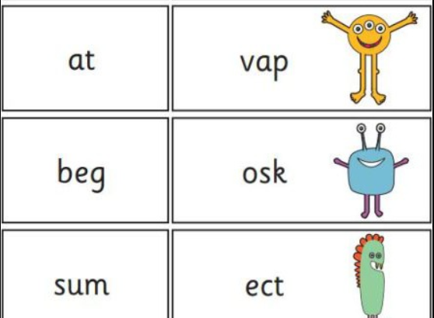
Year 1 Phonics
Screening Check
Notes:
In June, all year 1 children are expected to complete the year 1 phonics screening check.
The aim is to check that a child is making progress in phonics. They are expected to read a mixture of real words and ‘nonsense’ words.
If a child has not reached the expected standard, schools must give additional support to help the child to make progress in year 2.

Slide 20
The 6 Phases of Phonics
Phase/Level | When is this taught? | What does it cover?
1 | Preschool/ Foundation | Listening & attention skills
2 | Foundation | Alphabet sounds
3 | Foundation | Alphabet sounds + digraphs & trigraphs
4 | Foundation/ Year 1 | Longer words. More Tricky words.
5 | Year 1 | Alternative pronunciations/spellings
6 | Year 2 | Develop fluency and accuracy
Notes:
In Phase 6 – which takes place by the end of Year 2
Recognising phonic irregularities and becoming more secure with less common grapheme – phoneme correspondences.
Applying phonic skills and knowledge to recognise and spell an increasing number of complex words.
Introducing and teaching the past tense
Investigating and learning how to add suffixes
Teaching spelling long words
Finding and learning the difficult bits in words

Slide 21
Phonics Lessons
Revise: The children will revise previous learning.
Teach: New phonemes, high frequency or tricky words will be taught.
Practice: The children will practise the new learning by reading and/or writing the words.
Apply: The children will apply their new learning by reading or writing sentences.
Notes:
From Foundation Stage 2 to Year 3 all phonics lessons follow this format
Sequence in lesson of revisit/revise, teach, practise, apply

Slide 22
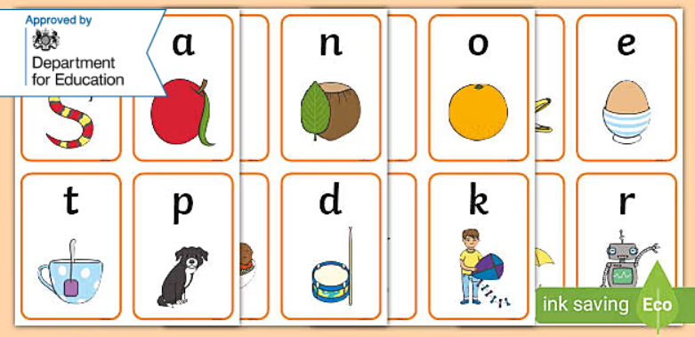
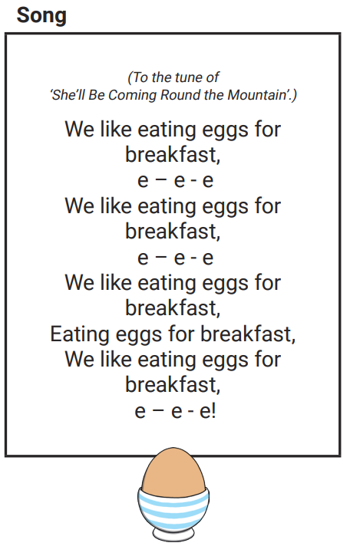
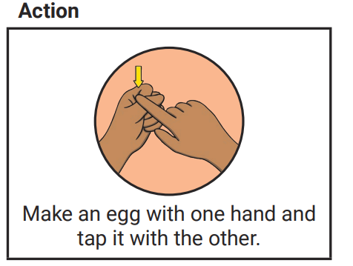
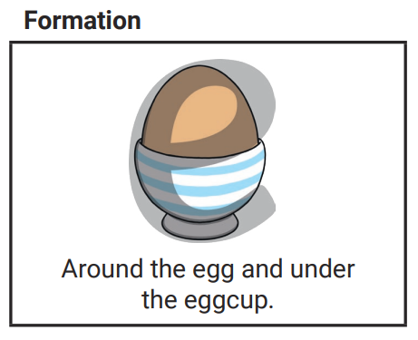
Every grapheme has mnemonic devices to aid recall – picture, action, & song
Every letter has a handwriting formation phrase
Notes:
Within the scheme every grapheme has a
Mnemonic devices help us to remember and retrieve information.
This can be essential for young children to jog their memory,
and for children with additional needs these devices enable the learning to be multi sensory which can aid processing and recall, particularly for kinaesthetic learners.
An added benefit is that multisensory techniques are quite motivating and engaging to many children.

Slide 23
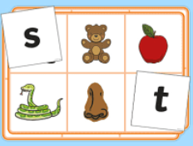
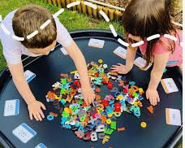

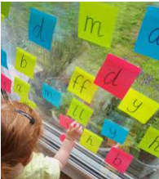
Phonics is fun!
The children learn and practise their phonemes in lots of fun ways:
Sound talking and rhyming.
Playing games – table games or interactive games on the big screen/ipads
Using phoneme frames, “sound buttons” and whiteboards to spell words.
Sorting phonemes.
Making words with phonemes.
Being phoneme “detectives”.
Reading and writing sentences. Silly sentences are great fun!
Notes:
Repeated exposure to the sounds and continual practice of the skills to blend and segment are what helps children to embed the knowledge to the point of automaticity – we want the recall to be instant in their mind when they see the letter – this is a ‘s’ it makes the sound /s/
This does not happen overnight for most children. We need to practice, practice, practice.
There will always be opportunities to practice and apply the knowledge and skills through activities and games in the continuous provision – this makes the learning more fun, and children can practice what they want to practice. Children are very good at self selecting the activities that practice their next steps.

Slide 24
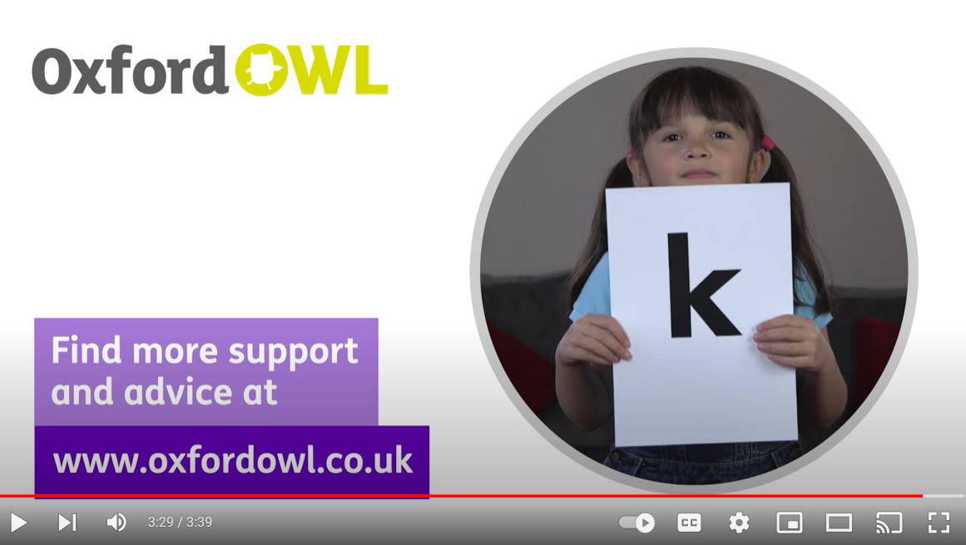
Pure Sounds Pronunciation
(How to say the sounds)
Saying the sounds correctly is essential for blending and segmenting
Notes:
Saying the sounds correctly with your child is extremely important
The way we say sound may well be different from when you were at school. Don’t beat yourself up if you make a mistake – it takes a lot to undo the learning we have previously had. Just correct yourself, or even take the opportunity to talk about how everyone makes mistakes and that’s ok. Mistakes are opportunities to learn more than we knew before.
We say the shortest form of the sounds to aid blending and segmenting.

Slide 25


dot
Notes:
An example –
When pronouncing with pure sounds, this word is easy to match to the correct picture. But if you don’t pronounce carefully…
Duh/o/tuh
It would be easy to get confused!

Slide 26
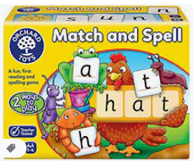
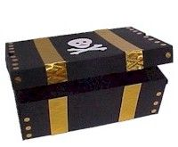
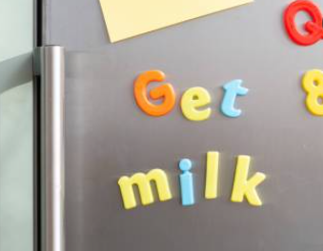
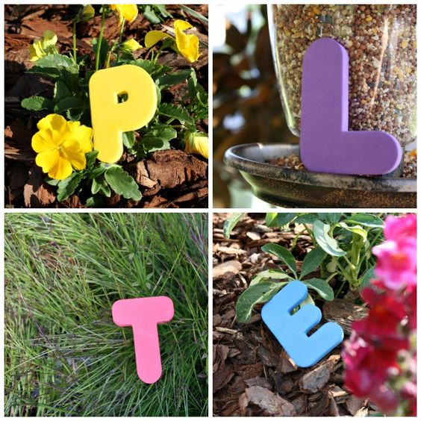

Ways to help at home…
Look out for the sounds information on Tapestry
Practice the new sound – over and over!
Try to use the sound when talking about the letter
Look out for reading practice books in book bags
Leave magnet messages
Phonics based games
Go on a treasure hunt, reading clues along the way.
Go on a sound hunt in the garden or around the house.
Target practice: Hit the grapheme or word with the football!
Notes:
We will inform you on Tapestry of the sounds we are learning in school – please help your child to practice the sound at home – spot it in your surroundings, point it out in reading books and signs, draw it – on paper, in the mud, on the steamed up mirror. Leave post-its of the sound around your house. Play i-spy with it, point out everything you see that starts with the sound. Sing the song until you’re hearing it in your sleep!
Repeated exposure to the sound will embed it into your child’s memory banks until it is automatic for them.
Try to use the sound rather than the letter name.
As and when your child is ready we will send decodable books for your child to read at home. Please read with your child daily if at all possible – including weekends!

Slide 27
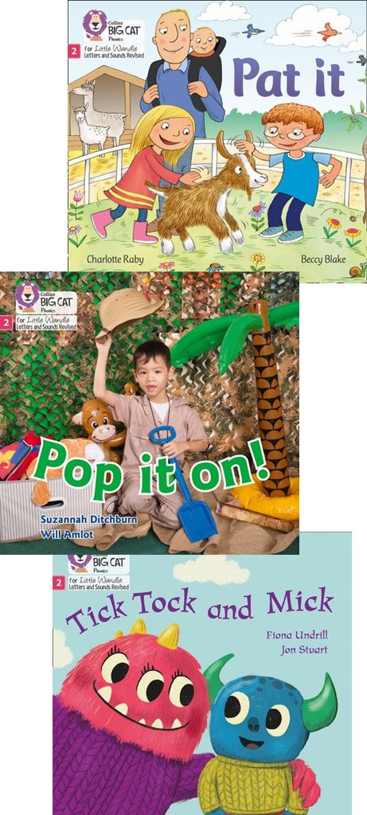
The reading practice book
Parents/carers play a vital role. Children who practice reading at home are more likely to become fluent, confident readers.
Parents’ or carers’ support is needed to help their child practise reading and develop fluency with a book they have already read at school.
Matched to your child’s phonics stage – fully decodable.
Changed weekly in school.
Re-reading the same book develops confidence and fluency.
It is just as important to practice comprehension skills as decoding skills.
Notes:
It is the school’s role to teach reading, but you play a vital role at home.
This book should to be matched to your childs phonic stage and be fully decodable. If books are sent home that the child cannot decode, it will lead to frustration for the child and the parent/carer.
To ensure that reading at home is an enjoyable experience and does not feel like a chore, schools need to send home reading practice books in which the child can read 95% of the words. Please let us know in the reading diary if your child has found the book too challenging or you are getting lots of resistance.
It does not have to be a different book every time; it may need to be the same book if the child still needs to develop fluency.
Comprehension of what you are reading goes hand in hand with the decoding skills – talk about what your child has just read – do they understand it? Discuss the pictures, the characters, what they do in the story. How might they be feeling?

Slide 28
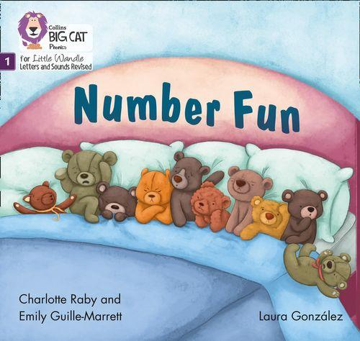
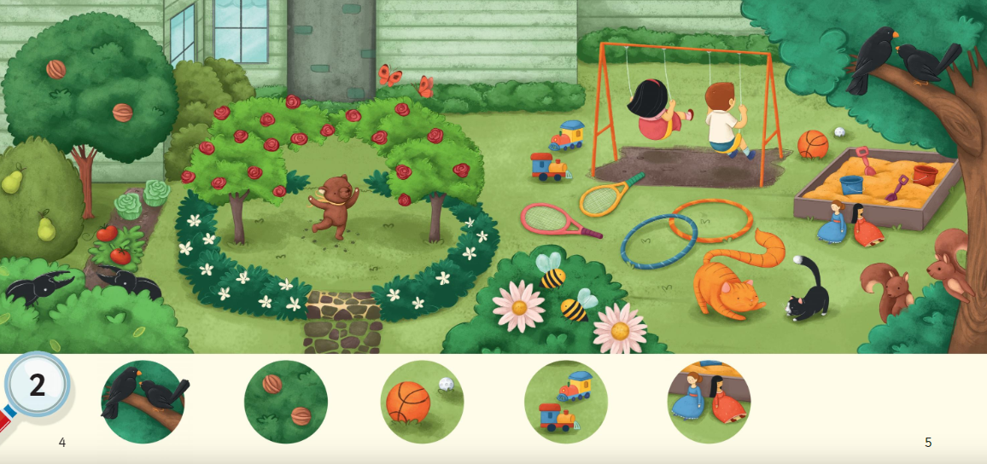
Books without words
Notes:
At the start of your child’s phonics journey they may bring home some books without words.
This is a great opportunity for developing comprehension skills and starting to retell the events of the story.

Slide 29
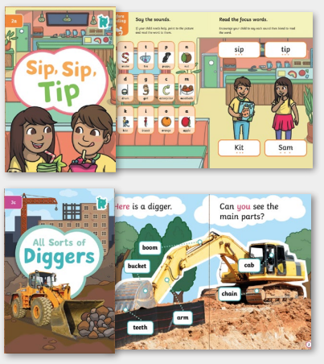
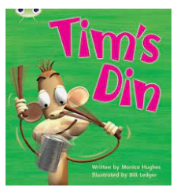
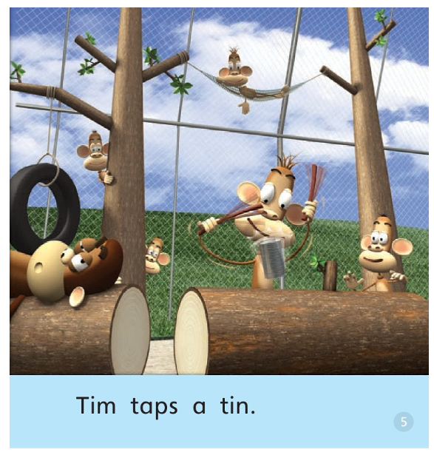
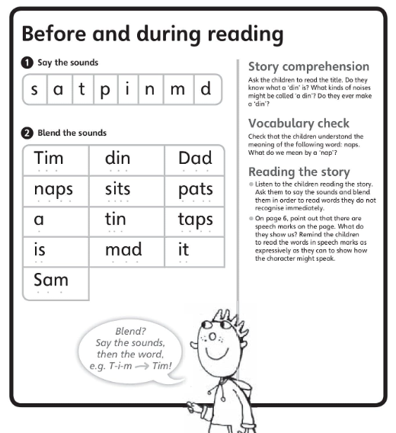
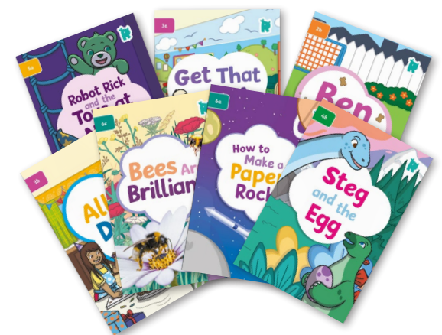
Books with words
Notes:
As your child becomes confident in their blending and segmenting they will start to bring home books with words in – these start off very simply and progress as your child builds up their phonics knowledge and reading skills.
In the front or back of the books you will find sounds to practice, focus words, and comprehension questions. Please include these in your reading practice.

Slide 30
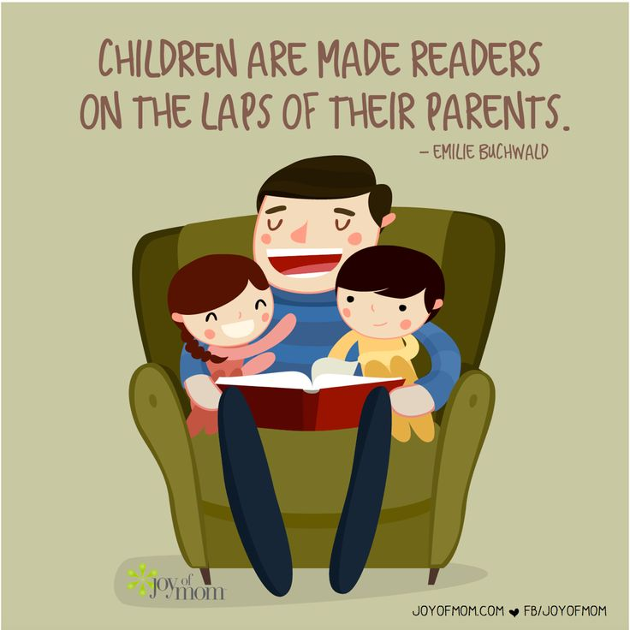
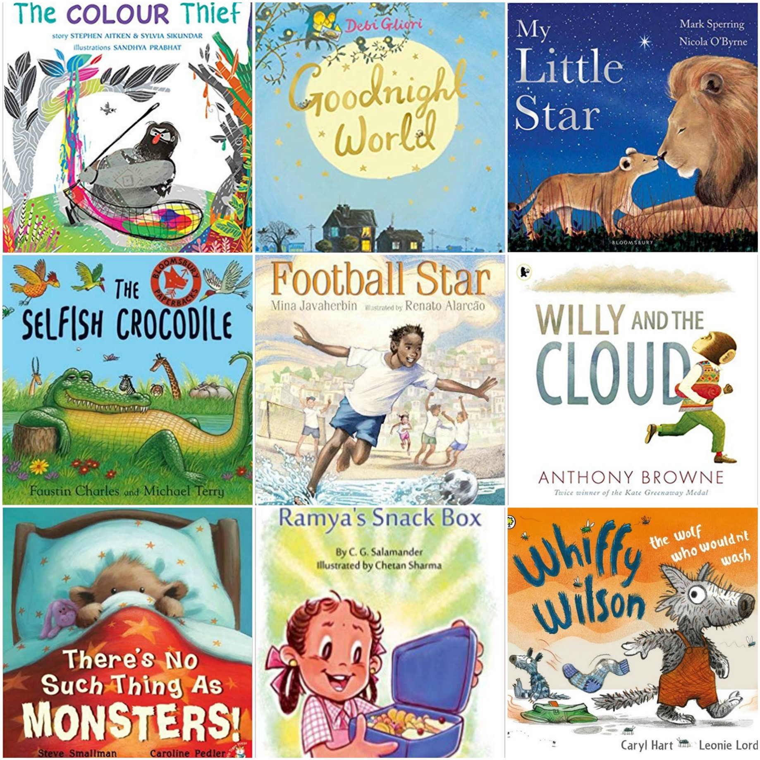
The sharing book
Your child’s choice of book from the library
The book is for the parent/carer to read to or with the child.
The goal is enjoyment.
Notes:
If children are to become lifelong readers, it is essential that they are encouraged to read for pleasure. The desire of wanting to read will help with the skill of reading.
Alongside their reading practice book children are invited to choose a story book from our library to bring home. This is to read for pleasure – perhaps as a bedtime story. You can supplement with your own books from home
Parents/carers should not expect their child to read this book independently, it is not matched to their reading level. This is for you to read to them to develop a love for reading. Children need to see the purpose of learning to read – sharing the magical world of books with them is essential to boosting their motivation. It’s also a great moment of bonding – time to unwind and distress, away from screens and the pressures of life. I’ve yet to meet a child who does not love to listen to a story with their favourite adult.

Slide 31
Writing
Notes:
A quick word on writing

Slide 32
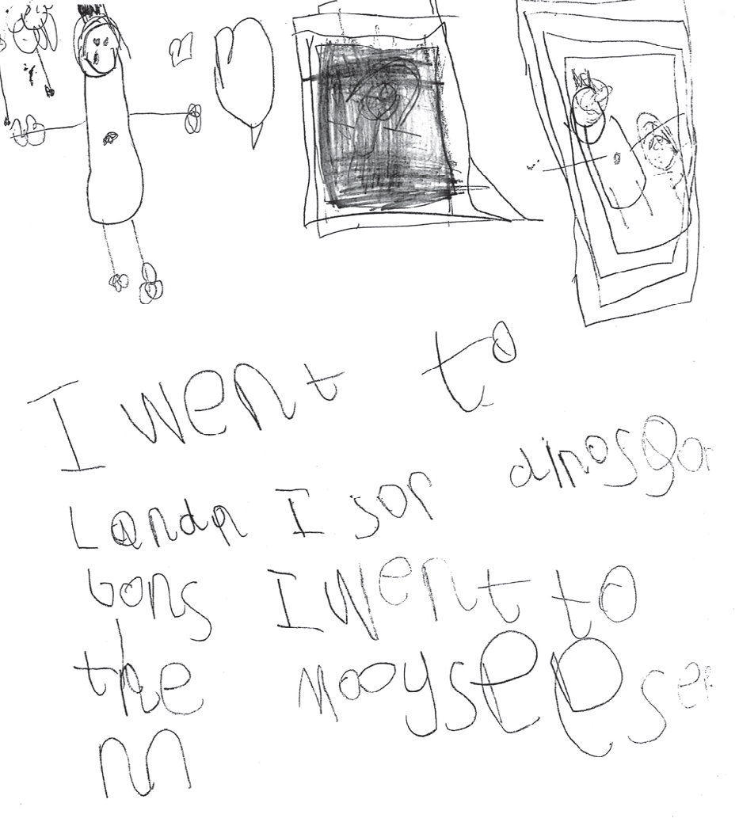
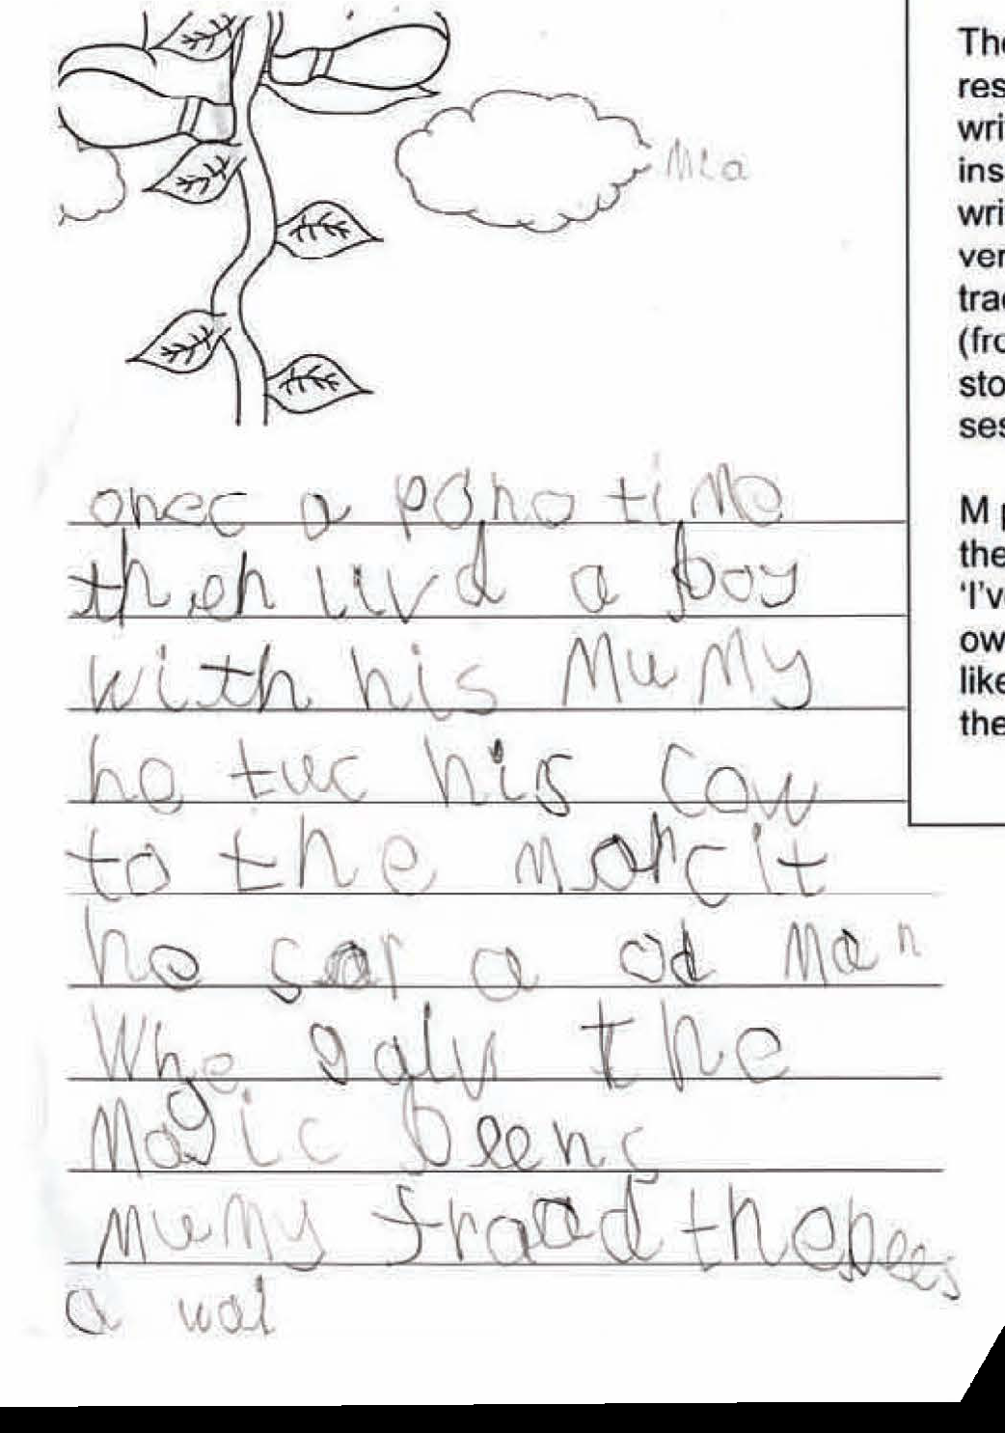
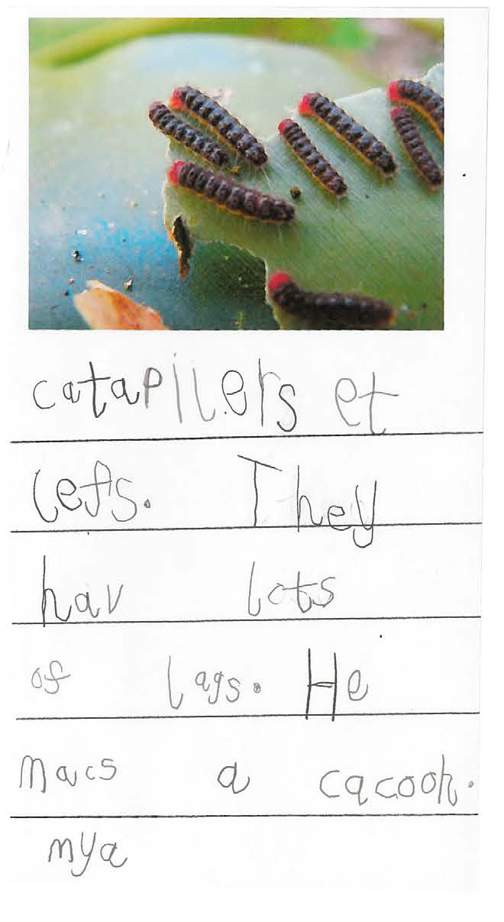
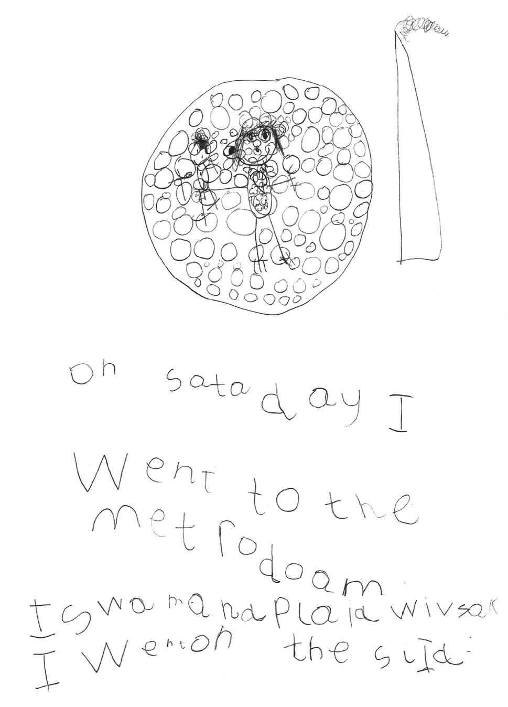
End of Reception Year
Notes:
This is what we are aiming for by the beginning of year 1.
These sentences are phonetically correct, the letters are recognisably formed
The children have used tricky words and digraphs in their writing.

Slide 33
Notes:
To achieve that level of writing your child will need to be able to hold a pencil and control it well for enough time to write the sentence. This can be very challenging for young children who are still developing their shoulder, arm and hand strength.
This picture shows the development of a child’s pencil grip – you might recognise your child’s pencil hold from one of the pictures. We are aiming for a dynamic tripod grasp.
Encourage your child to grip the pencil between two fingers and their thumb, in a tripod grasp. While initially uncomfortable this will eventually become second nature and will help your child to increase their pen control. Young children are still developing their fine motor strength so maintaining a tripod grip can be tricky for some children.
Lots of the activities we do at school are designed to develop fine motor control to enable your child to manage writing without a struggle.
If writing is physically hard then the child is not going to want to do it.
If you notice your child is reluctant to write, or colour, it would be worth checking their pencil grip. If they are struggling with the grip then some strengthening activities would benefit them

Slide 34
Strengthening their fine motor skills/ pre-writing skills
Notes:
There are many ways to encourage a child to develop their fine motor control and to strengthen their hand muscles.
Using tweezers and tongs
Threading and laceing,
Playdough – also making pastry, baking etc
Using scissors – snips in paper – other materials – playdough, leaves, grass, etc
Peg boards, anything small and fiddly like jigsaw puzzles, lego
Pegging – get them to help with the washing!
If your child is very active then more physical activities might be more their thing – climbing frames, monkey bars, holding on to the ropes of the swing, pushing wheelbarrows, sweeping and raking, digging, riding bikes, crawling/walking on hands and feet, bat and ball games,
Fine Motor rucksacks in our Play to Learn Loan Library

Slide 35



Writing at home
Praise your child for ‘play writing’.
Write with your child- ‘think out loud’
Spellings- phonetically spelt.
Encourage correct formation of letters and use of lowercase
Give your child a purpose for writing:
Send an email to family
Write a birthday card
Writing labels
Write a shopping list
Treasure maps
Notes:
Encourage them to write in their play – signs for small world, letters, postcards etc, a message from the King! A secret message from a superhero,
Let them see you writing – shopping lists, notes to each other, crosswords, birthday cards
Lots of praise for any attempt, for reluctant writers resist the urge to correct them at all.
Children will spell things with the phonics they know – if it phonetically makes sense then it’s great writing! They will learn spelling later, so resist correcting them – it can be very demoralising
Gently correct letter formations, especially reversals of letters – again pick your battles – don’t highlight every error in their writing, perhaps just one to practice the letter formation of – model the correct formation and ask them to practice it.
It’s essential that children see that writing has a purpose. In the modern age with all our digital technologies this is less visible to children. Think about the times that you physically write with a pen or pencil rather than type.
Encourage children to join you in these writings for a purpose – it can be digitally as well – writing an email to a family member is great for thinking about what to write and composing sentences – if you’re telling them what you’ve been doing its great practice of past tense sentences too!
Writing birthday cards – this could start with just writing their name at the bottom with your own, extend to what sounds they can hear in ‘happy birthday’
Writing labels – or signs – if they’ve made a lego creation, perhaps they could label it so other people know what it is? Ask them to help you label up toy boxes or trays of food for a party, get some post it notes and label everything in sight!
Treasure maps – a great motivation for small children and a fantastic adition to role play games. Label the obstacles on the map
Also clues for a treasure hunt
Shopping lists – perfect for role play but also real life. If they are coming shopping with you give them their own list with 2 or 3 things on that they need to find. Good practice reading the list to check.
Recipes – read the instructions together.

Slide 36
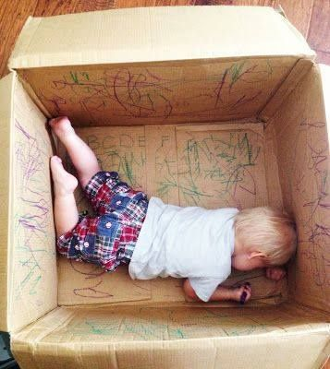
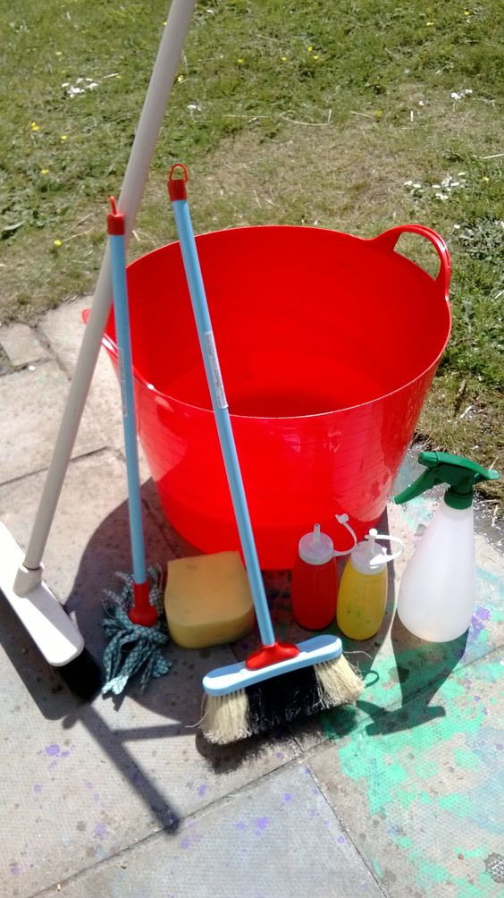
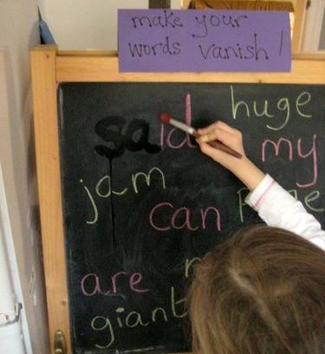
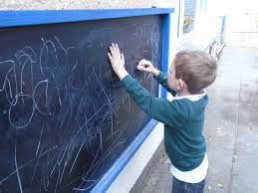
Make writing fun!

Slide 37
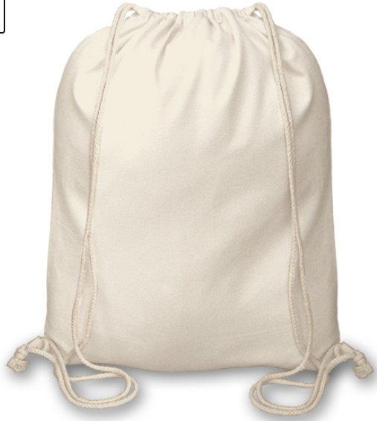
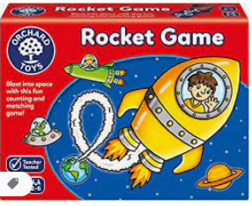
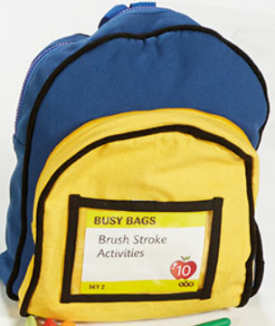

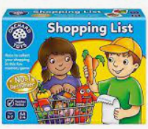
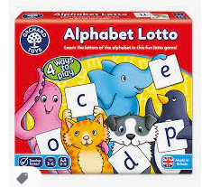
Play & Learn Library
Play & Learn Library
Loan Bag 21
Bug Hunting Kit
Notes:
We are introducing this year Stockham’s Play to Learn Library
We have developed a number of bags that you can borrow for a week to use at home.
Hopefully it will enable you to provide your child with lots of ‘new to them’ toys to use at home, recycling the toys will help the environment and hopefully your pockets too!
Each bag contains a play based activity that will benefit your childs development in different ways.
Many of the bags will encourage speech, communication and language skills which will benefit your child’s reading and writing.
Some of the bags are specifically for fine motor development.
We have included games in the library – many of which are phonics specific. All board games have a number of developmental benefits for children.
Each bag includes an activity guide, which will help you with how to do the activities and the reasoning behind the play.
Children learn so many skills through play which are essential to their development and aid their reading, writing, maths, social skills, physical development, understanding of the world, expression, creativity, problem solving and many more.
The bags will be based under the canopy in Foundation – you can sign out your choice of bag on the sign out sheet.
When you return the bag, please pop it in the returns box so that staff can clean resources and replenish any papers etc that have been used up while on loan, and write the date of return on the sheet.
We imagine that you will want to keep a bag for a week and because we have limited bags at the moment we would ask you to return yours after a week to enable other children to experience the bags too.
If you want to return the bag sooner you are welcome to do that too.
Please do try to return all the contents of the bag in good, clean condition – if you aim to keep them together while using the bag and put them back in after use it should be easy to locate everything when you need to return it. If you do lose anything, please pop a note in the bag when you return anything and we will try to source a replacement.

Slide 38
How to help at home
Make reading purposeful e.g. read cards, messages, letters together
Read stories to your children.
Make them fun!
Play with magnetic letters to leave each other messages
Don’t ask your child to read if they don’t want to, or put them on the spot
Look at traffic signs, shop names, labels and adverts
Play games that encourage reading e.g. Orchard games, or Top Trumps
Ask “Does that make sense?” rather than correcting your child if they make a mistake
Encourage your children to help you read shopping lists and recipes
Ask questions particularly if there is no correct answer
“Why do you think they did that?”
Surround yourself with books
Talk about the pictures and what is happening in the books
Read for pleasure yourself

